Slide 1
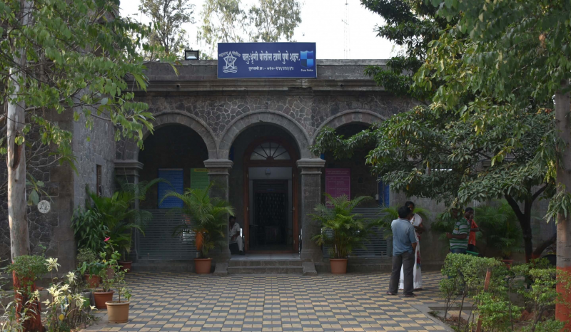
POLICE DUTY SCHEDULING

Slide 2
Team Members
230945920053 - SHUBHAM LOKHANDE
230945920044 - SAURABH KHARTUDE
230945920093 - ROHIT SHENDE
230945920033 - JAI PATANKAR
230945920067 - SHAILESH PATIL

Slide 3
Introduction
The Police Duty Scheduling System is a project designed to streamline and automate the process of scheduling police officers within law enforcement agencies. Efficient management of police duty schedules is critical for maintaining public safety, ensuring proper coverage, and preventing officer fatigue. This project focuses on developing a user-friendly and efficient system that leverages technology to simplify the scheduling process, taking into account various factors such as officer availability, preferences, and organizational requirements.

Slide 4
Technologies Used
Spring Boot
React JS
MYSQL

Slide 5
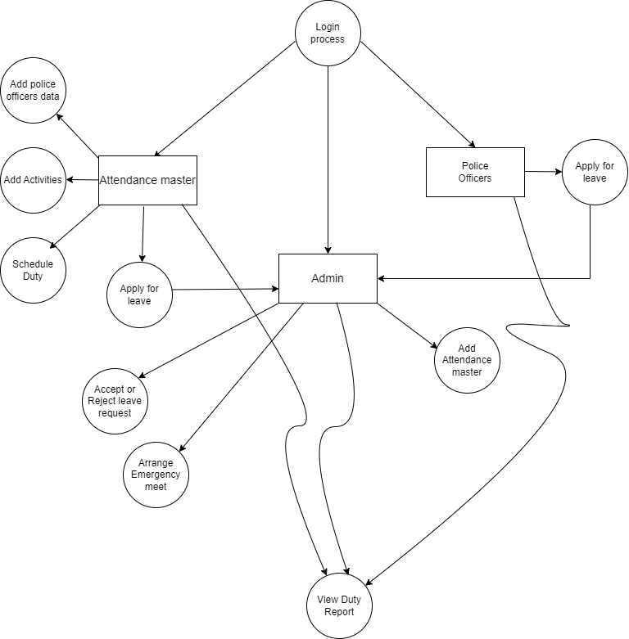
DFD

Slide 6
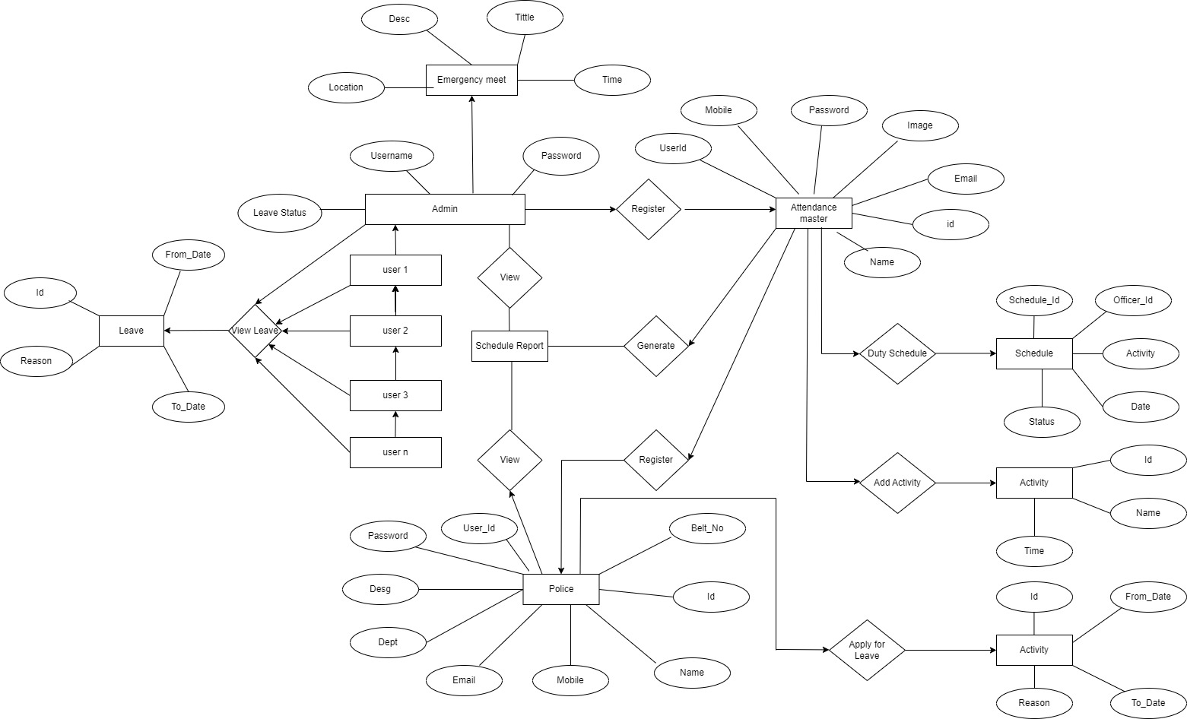
ER Diagram

Slide 7
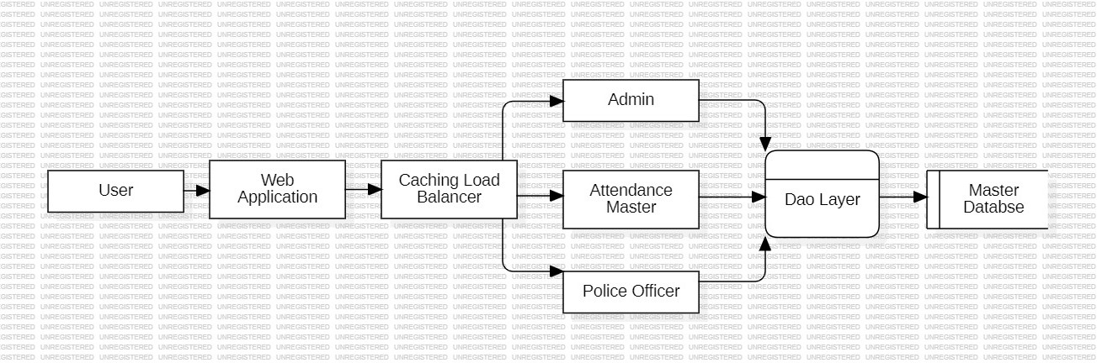
System Architecture

Slide 8
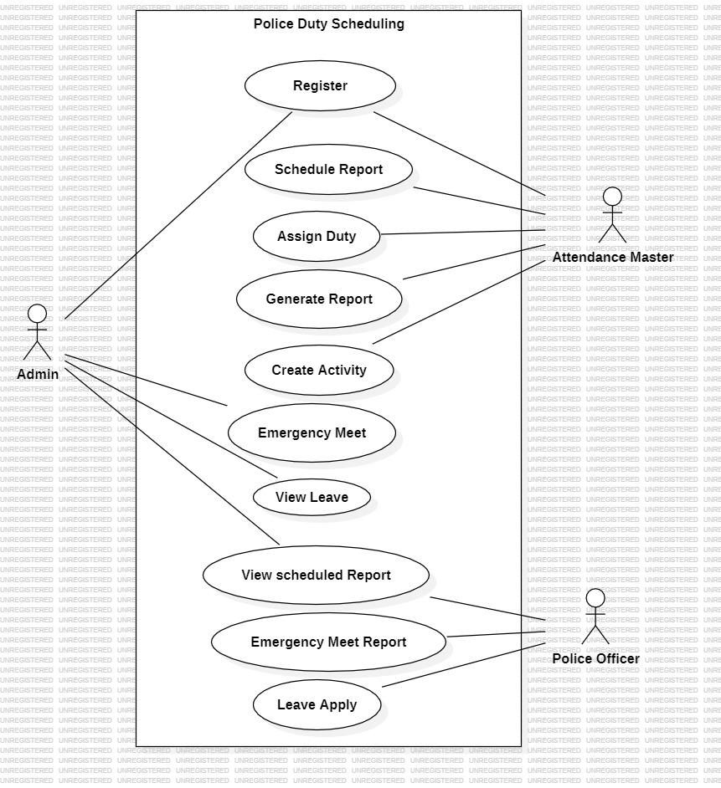
Use-Case Diagram

Slide 9
THANK YOU !!!

